Slide 1
Interpretable Transformer-Based Diagnosis of Lung and Colon Cancer Using Histopathological Images
Presented by
Group-5
22166030 Shakib Mahmud Dipto
22166047 Irfana Afifa
22366021 Nadia Tasnim Mim

Slide 2
Abstract
This thesis provides a novel method for lung and colon cancer diagnosis that blends interpretability with the strength of transformer-based deep learning. The proposed method converts histopathology pictures into patches by taking advantage of the transformer architecture's capacity to record spatial connections and contextual data. Tests on sizable datasets of lung and colon histopathology images show that the interpretable transformer model performs well in correctly identifying lung and colon cancer. The research's conclusions and discoveries may help pathologists and oncologists make more accurate diagnoses and improve patient outcomes.

Slide 3
Introduction
Among the most common and deadly types of cancer worldwide are lung and colon cancer. Improving patient outcomes requires early and accurate diagnosis, which enables prompt treatment planning and action.
This thesis proposes a histopathological image-based interpretable transformer-based method for detecting lung and colon cancer. It converts histopathological pictures into a series of patches, where each patch corresponds to a particular geographic location of interest. Deep learning approaches have revolutionised medical image analysis, but lack interpretability. The outcomes and understandings gained from this study have the potential to greatly improve the diagnosis of lung and colon cancer, resulting in improved patient outcomes and individualised treatment plans.

Slide 4

Existing Works
As annotated histopathological images are hard to assemble on a large scale, self-supervised learning can be a possible solution.. Wang et al., with that possibility in mind, proposed a novel SSL strategy, Semantically-relevant contrastive learning (SRCL).
Tsai, PC. et al., developed the Multi-omics Multi-cohort Assessment (Moma) platform in order to identify and interpret the relationship between patients’ histologic patterns, multi-omics and clinical profiles in 3 spacious patient cohorts, in a systematic way. Their system was built in such a way, so that it could provide clinically usable predictions to inform treatments for the patients of colorectal cancer.
Researchers have done surveys of many papers and explored different AI techniques that contributed to the histopathological image analysis workflow and represented their overviews on various XAI and deep learning techniques in histopathological images.

Slide 5
Existing Works
It is a costly and hard process to obtain annotated histopathological image data on a large scale in the medical field. Therefore, most of the recent studies have focused on weakly supervised learning based on weak annotation, semi-supervised learning that uses limited annotation and self-supervised learning which uses pathological images for representation learning.
In this study, for end-to-end biomarker prediction using pathology slides, Wagner, S. J. et al., developed a fully transformer-based pipeline combining a pre-trained transformer encoder and a transformer encoder. This model was trained on thousands of pathology slides.
In this work, the authors proposed a convolutional neural network that was trained to gather the labeled samples in homogeneous clusters according to their characteristics through metric learning for the classification of histopathological images.

Slide 6
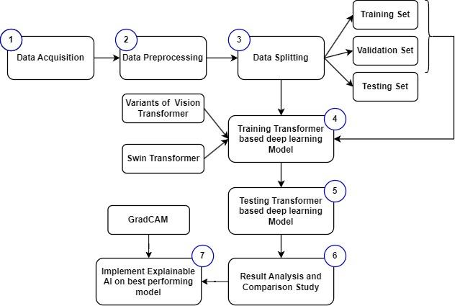
Research Methodology

Slide 7
Research Overview
Diagnosis Lung and Colon Cancer by a single system
Analysing the performance of transfer-based model
Explore the explainability of the Transformer-based deep learning model using GradCAM to diagnose lung and colon cancer from histopathological images.

